Slide 1
Union-Find Disjoint Set Data Structure
Lecture-12.1: Implementation of Union-Find Disjoint Set
Md. Golam Shahriar,
Lecturer, Dept. of CSE, VU

Slide 2
Union-Find Disjoint Set Data Structure
The main innovation of this data structure is in choosing a representative ‘parent’ item to represent a set
If we can ensure that each set is represented by only one unique item, then determining if items belong to the same set becomes far simpler:
The representative ‘parent’ item can be used as a sort of identifier for the set.
To achieve this, the Union-Find Disjoint Set creates a tree structure where the disjoint sets form a forest of trees.
The root of the tree is determined to be the representative item for a set.

Slide 3
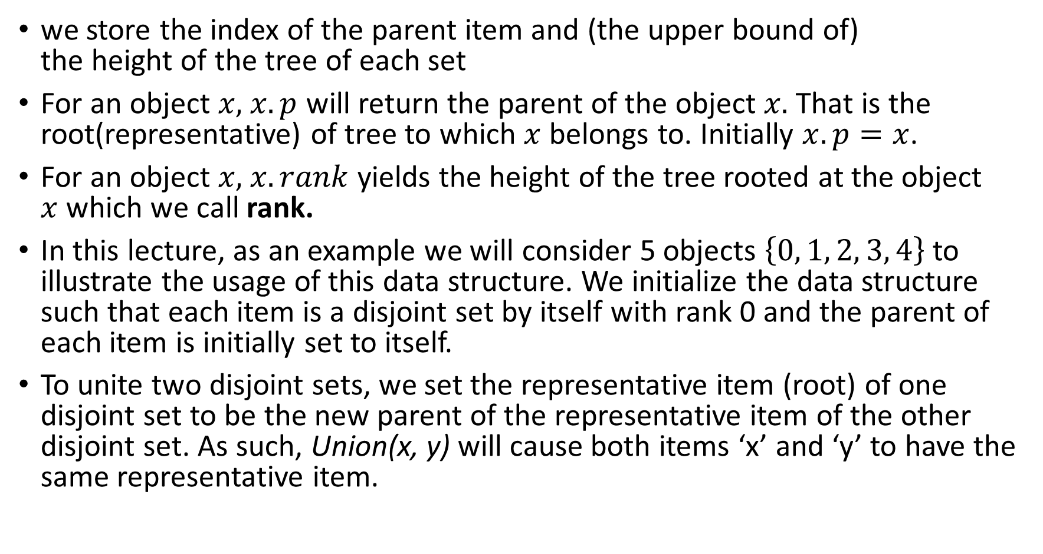
Union-Find Disjoint Set Data Structure(Continued)
we store the index of the parent item and (the upper bound of) the height of the tree of each set
For an object $x,$ $x.p$ will return the parent of the object $x.$ That is the root(representative) of tree to which $x$ belongs to. Initially $x.p=x$.
For an object $x,$ $x.rank$ yields the height of the tree rooted at the object $x$which we call rank.
In this lecture, as an example we will consider 5 objects $\left\{0, 1, 2, 3, 4\right\}$ to illustrate the usage of this data structure. We initialize the data structure such that each item is a disjoint set by itself with rank 0 and the parent of each item is initially set to itself.
To unite two disjoint sets, we set the representative item (root) of one disjoint set to be the new parent of the representative item of the other disjoint set. As such, Union(x, y) will cause both items ‘x’ and ‘y’ to have the same representative item.

Slide 4
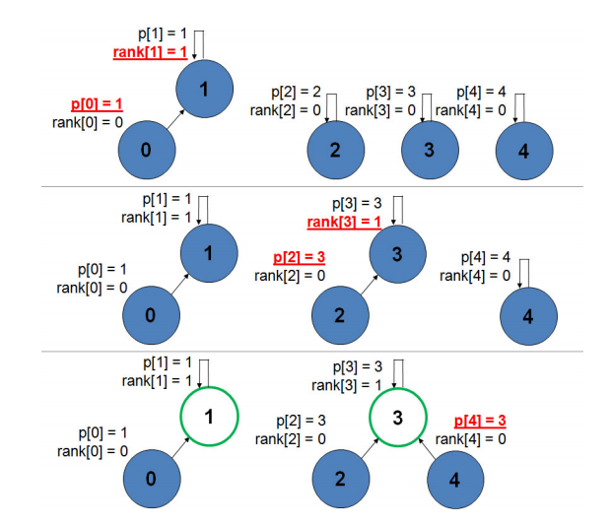

Slide 5
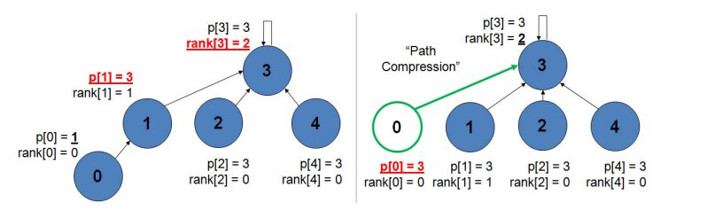
Path Compression

Slide 6

The Implementation
Make-Set($x$)
$x.p := x$
$x.rank := 0$
Union($x, y$)
Link(Find-Set($x$), Find-Set($y$))
Link($x, y$)
if $x.rank > y.rank$
$y.p := x$
else
$x.p := y$
if $x.rank = y.rank$
$y.rank := y.rank + 1$
The Find-Set procedure with path compression is simple.
Find-Set($x$)
if $x ≠$ $x.p$
$x.p :=$Find-Set($x.p$)
return $x.p$

